Slide 1
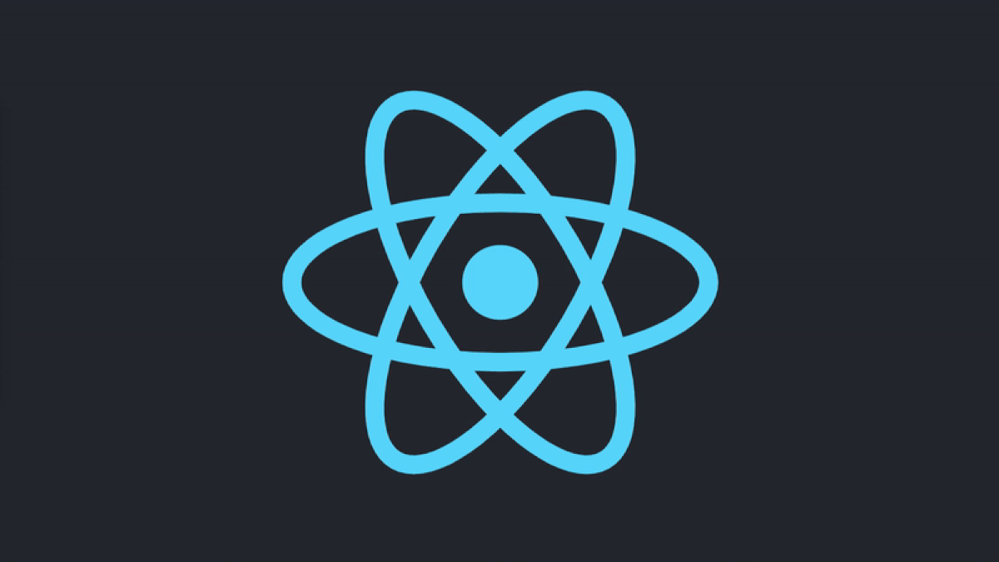
REACT WEBINAR

Slide 2
CONTENTS
Setup for the session – will give you starting point to follow this tutorial.
Overview – will teach you fundamentals of React (components, state, props).
Building simple React app.

Slide 3
SETUP
NodeJS - https://nodejs.org/en/download/
Visual Studio Code - https://code.visualstudio.com/download or any text editor.

Slide 4
OVERVIEW
What is React ?
React is a declarative, efficient, and flexible JavaScript library for building user interfaces.
It lets you compose complex UIs from small and isolated pieces of code called “components”.

Slide 5

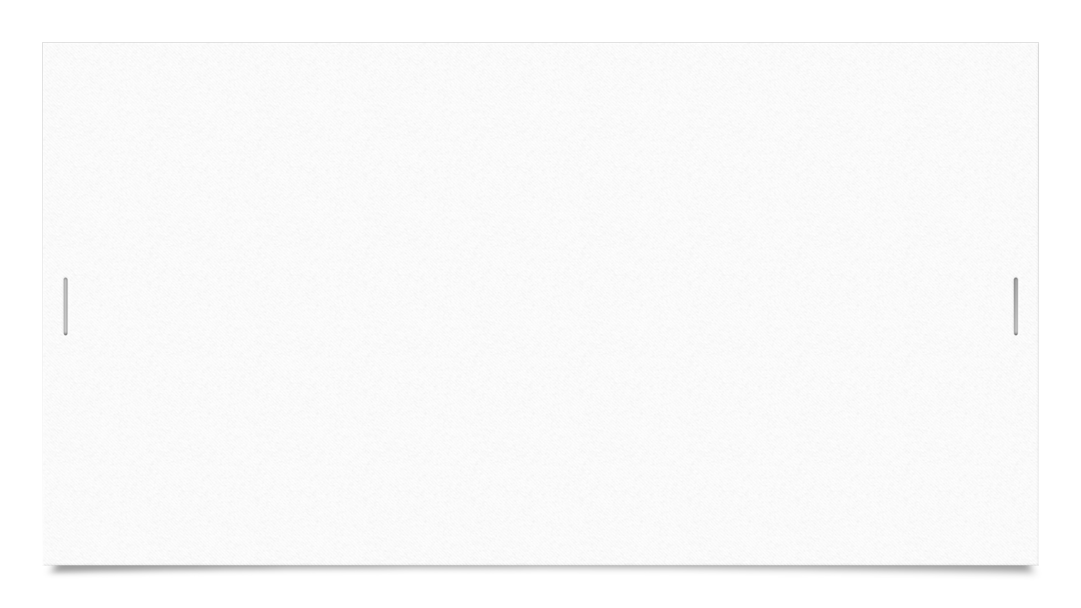
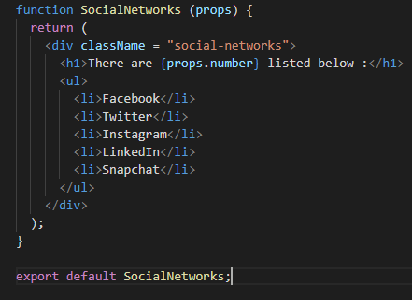

OVERVIEW (CONT…)
The snapshots attached shows basic React component.
For detailed overview you can visit https://reactjs.org/docs/getting-started.html

Slide 6

YOUTUBE SEARCH APP

Slide 7
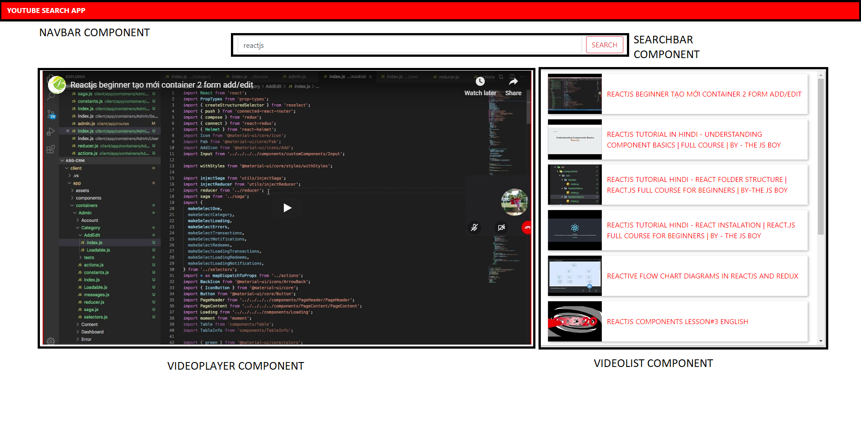

Slide 8
PROJECT SETUP
Create project :
Open terminal and type npx create-react-app <PROJECT-NAME>.
Head over to your project directory and type npm start.
Get your YOUTUBE api.

Slide 9
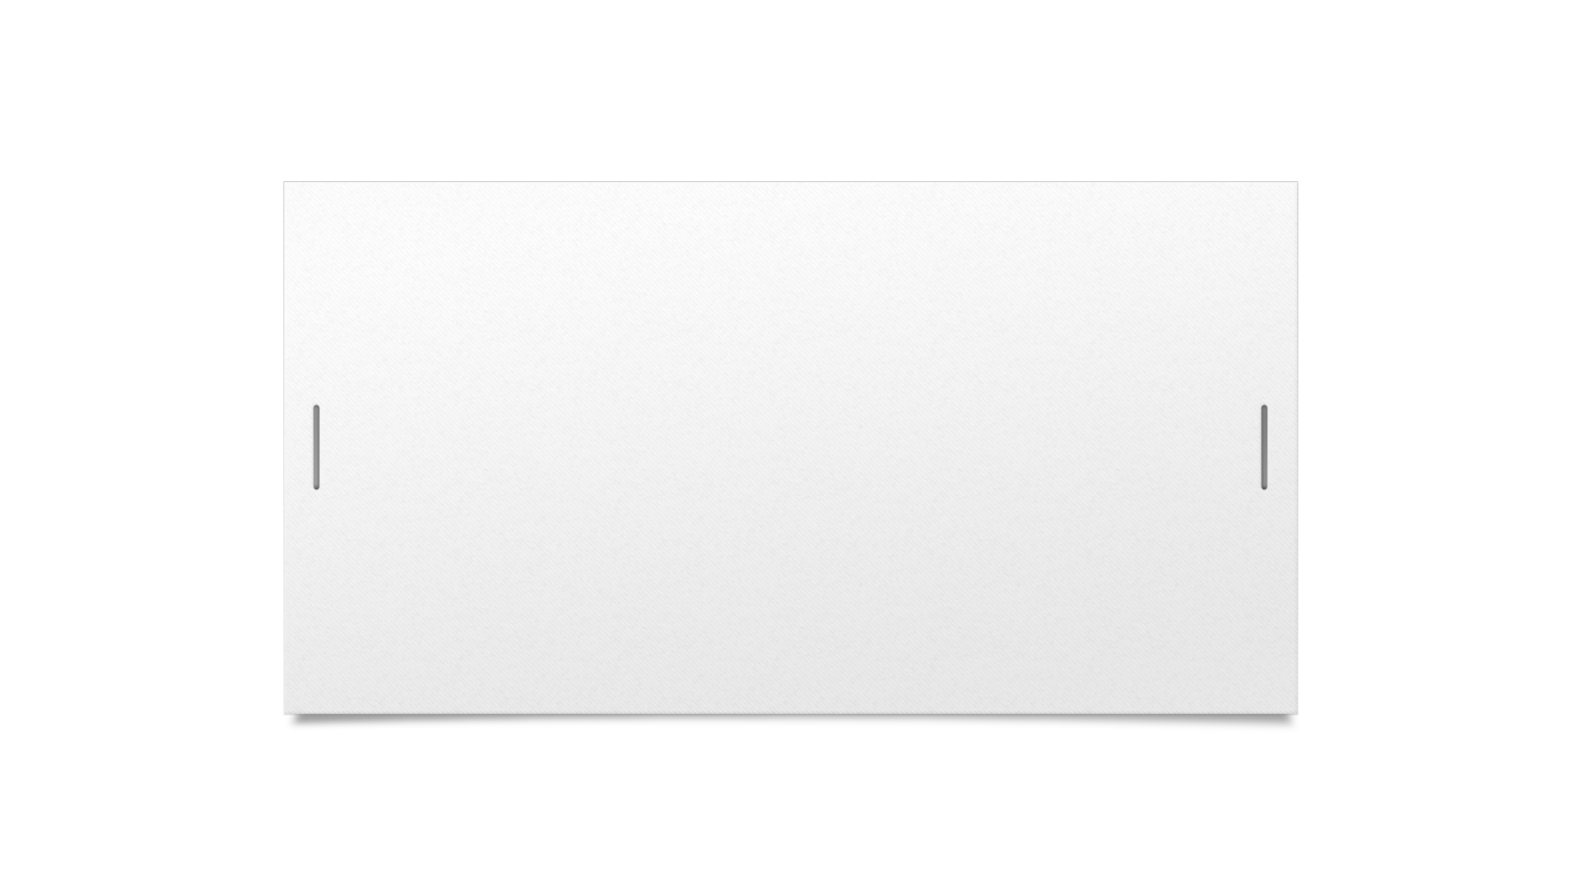
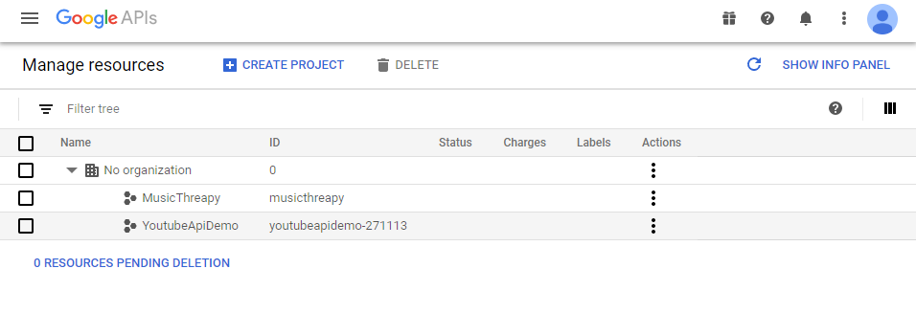

STEP1
Go to https://console.developers.google.com/project and create new project.

Slide 10
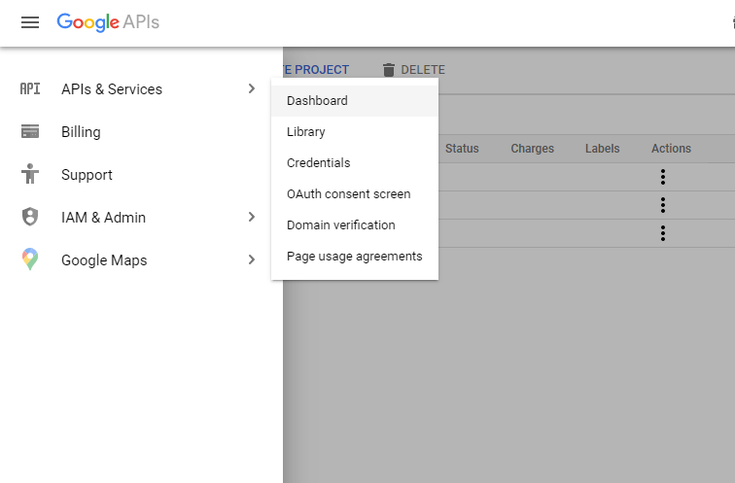
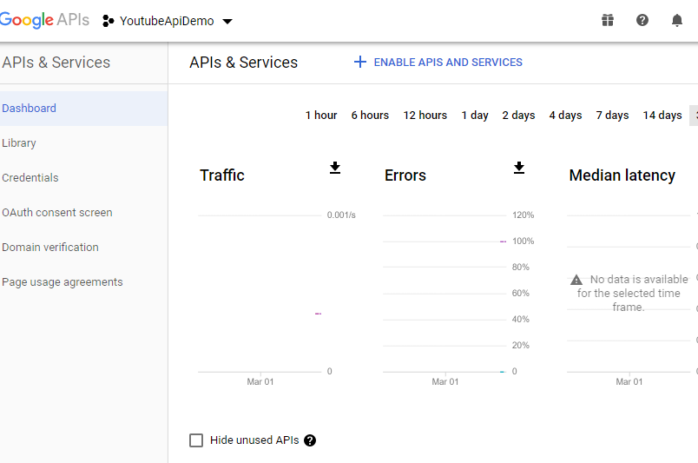
STEP2
After successful project creation head over to google api and services.

Slide 11
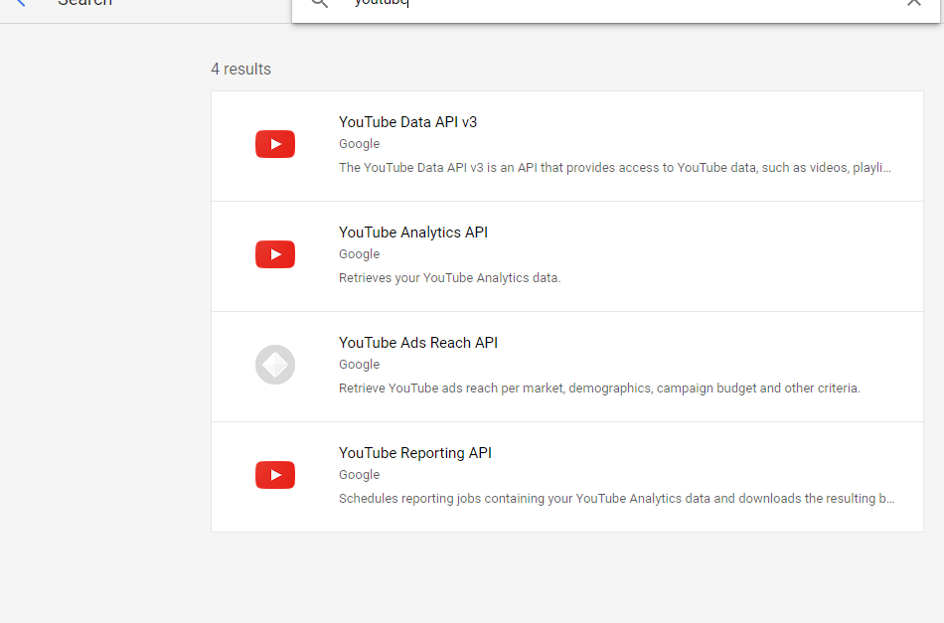
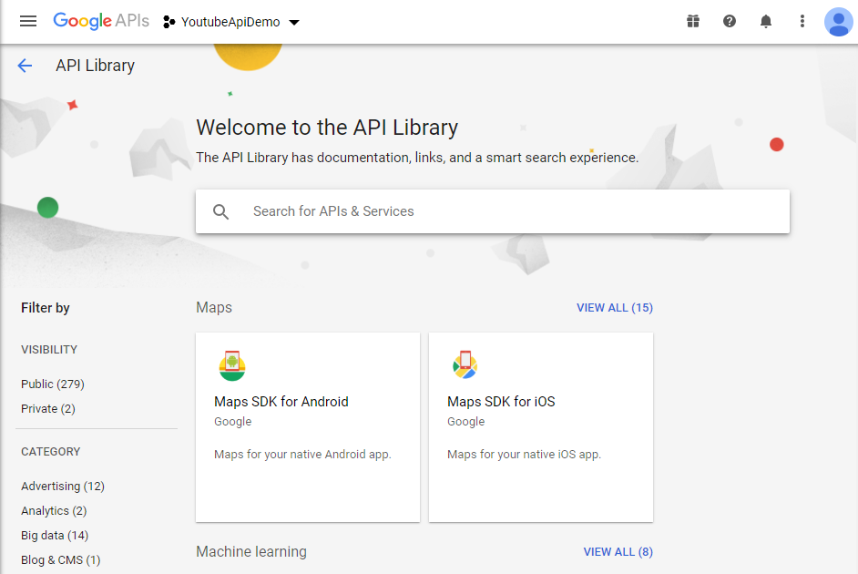
STEP3
Go to google api library and search for youtube api.

Slide 12
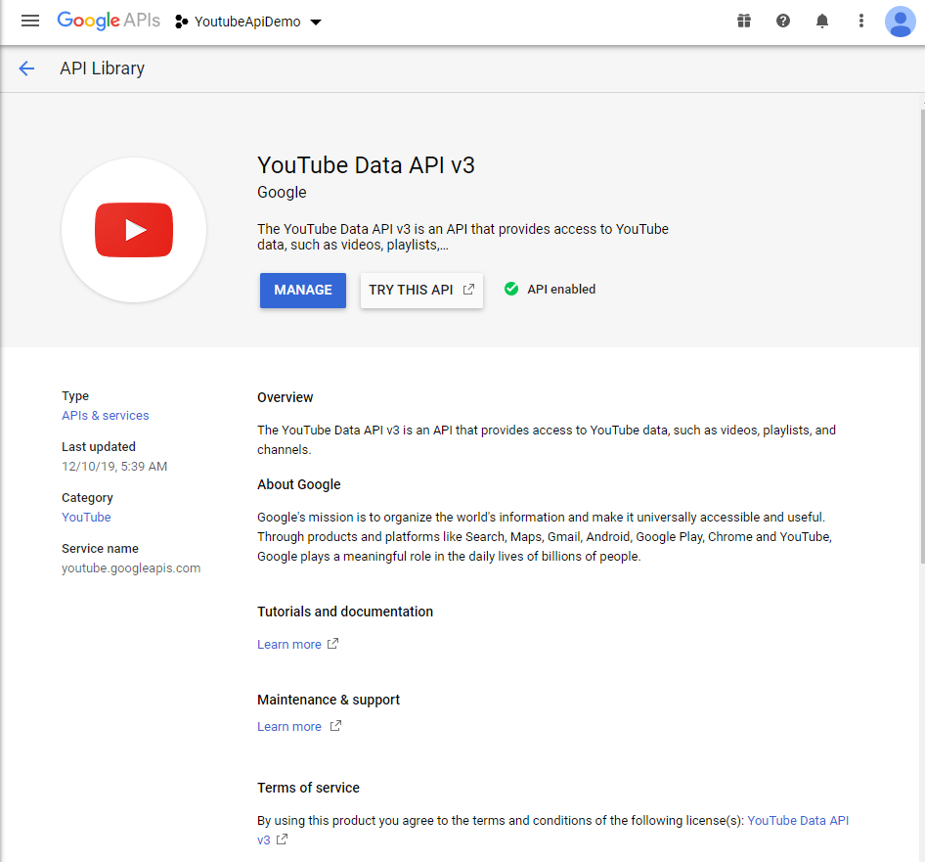
STEP4
Enable your youtube api.

Slide 13
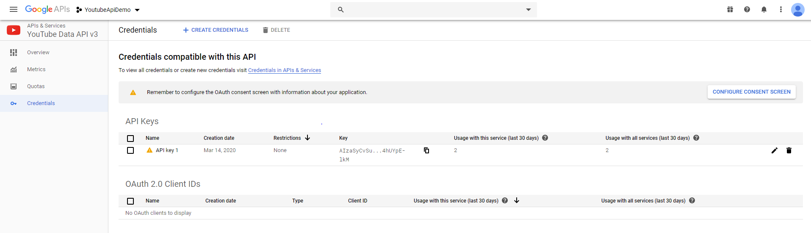
STEP5
After enabling your api click on manage and you will be redirected to page similar to one shown in snippet and create your credential.

Slide 14
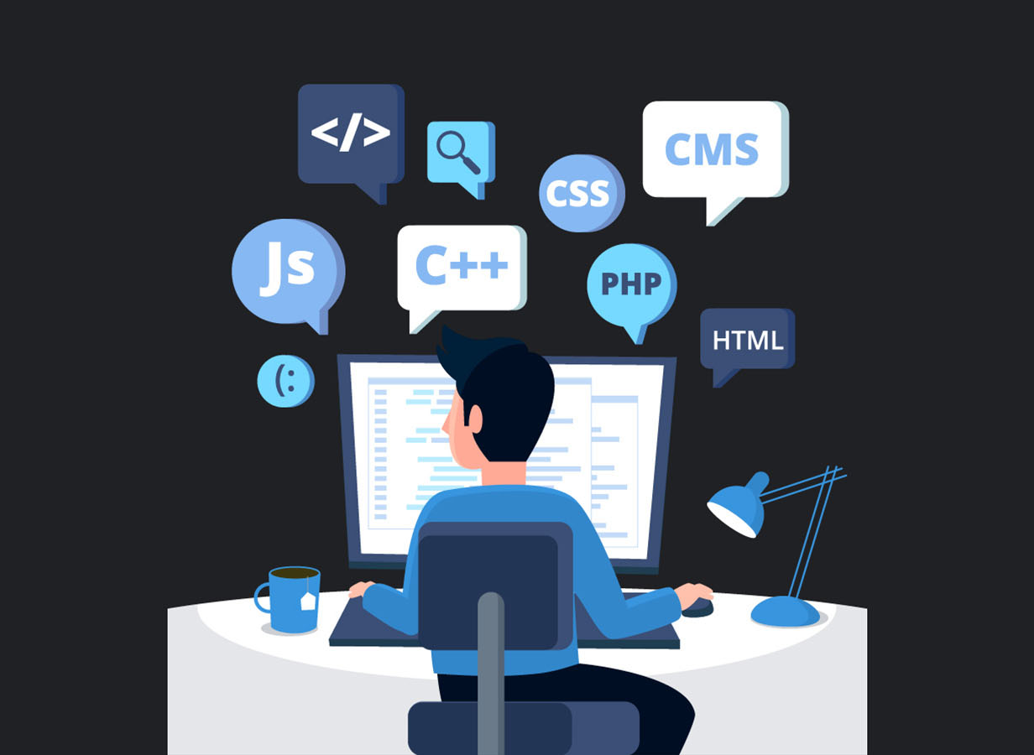
WHAT ARE WE WAITING FOR?
Let’s start developing our YouTube app.
You can find complete content at https://gitlab.com/swapnilmistry/greyatomwebinar.git

Slide 15


